Slide 1


Feb-2012
Team MSU - AOCI

Slide 2
Highlights
Motivation Behind MSU
What is MSU
Salient features of MSU
How easy to adapt/use MSU
Where we Stand after OTM
MSU Porting Options

Slide 3
Highlights Cont….
MSU Cyber Security Aspect

Slide 4


Motivation Behind MSU
TeSys-T had a firmware issue because of which 7000 devices had to be re-programmed!
It uses FTP for upgrading devices
Though FTP is reliable it has some disadvantages:-
  Manual interventions ( Identify the IP address of each device and then establish the connection before sending files).
  Even if there are many devices of the same hardware type and they use the same binary file, the procedure is repeated.
  Uses more network resources (wrt Bandwidth)
  Takes long time if there are many devices.

Slide 5

What is MSU
MSU is a protocol with Client- Server Model based on UDP/IP
  MSU Server is hosted on PC
  It has a GUI from which user can choose the file ( Binary, Executable etc) to be sent on the devices who needs an upgrade
MSU Clients is part of the Device Firmware
  MSU client is developed in C and it can be ported on the devices or is also available as a C library

Slide 6
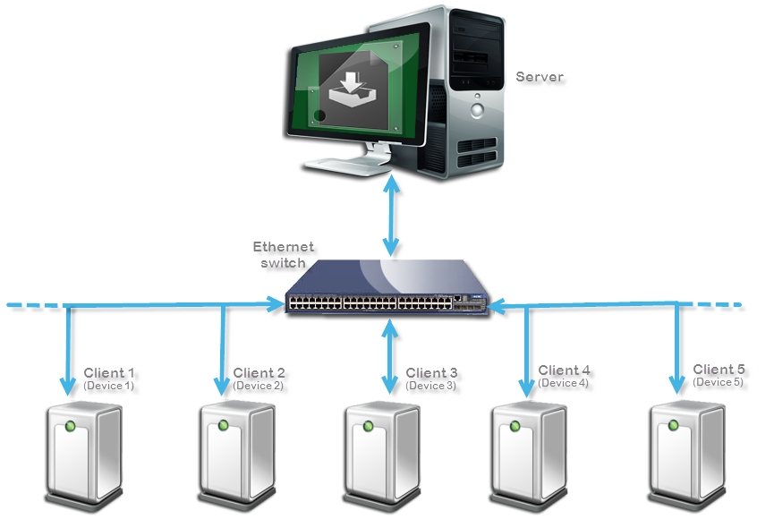
Example of an MSU scenario

Slide 7

Salient feature of MSU
MSU can perform simultaneous file transfer to may devices on the network
Bandwidth consumption will always be equal to 1 device
Time consumption will always be equal to 1 device
MSU creates list of the devices on the network before to start the process
Apply upgrade process on selected group (s)of devices
Multiple groups can be selected simultaneously (different Binaries)
Gives the Status about the devices whether they passed, failed or faulty at the end of upgrade process
Status of file transfer is validated by CRC at the end of file transfer (Optional can be enable/disable by compile time MACRO)

Slide 8
File handling by MSU
Sequence 1
Sequence 2
Sequence 3
Sequence 4
Sequence Size <= UDP data payload
Chunk size = Sequence Size X no of sequence
Sequence 32
Chunk 1
Chunk 2
Chunk n
File

Slide 9
MSU Server Implementation
Divide file in to equal size call chunk
Chunk further divided in to equal size call sequence
Take one chunk and transmit one by one sequence till current chunk finished
Wait for a time period call Sequence Complain (SCM)
Devices those have missed few sequences can ask for retransmission from server
Retransmit the missed sequence if any
Repeat step 3 to 6 till reach the last chunk

Slide 10
MSU Server Implementation Cont…
Wait for a time period call Chunk Complain Mode (CCM)
Devices can ask for retransmission of missed chunk
Retransmit the missed chunk if any
End the process and wait for the status of all devices

Slide 11
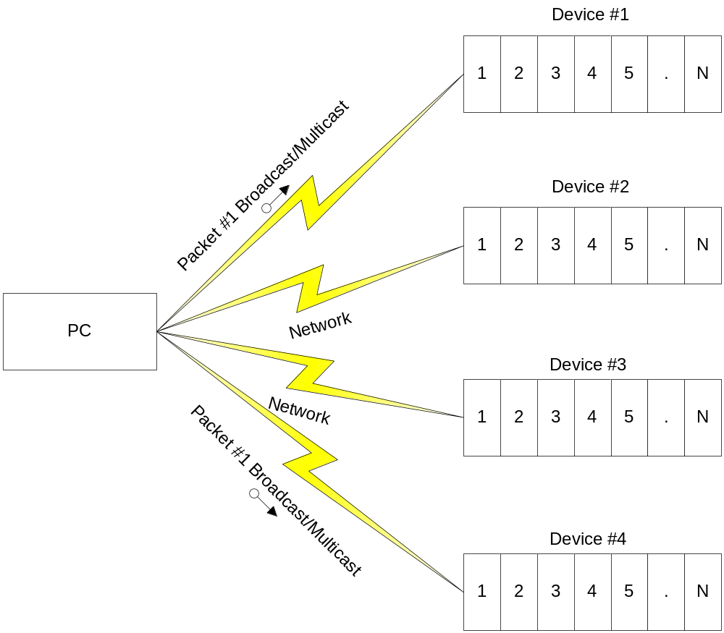
The Proposal of “Mass Up-gradation”

Slide 12
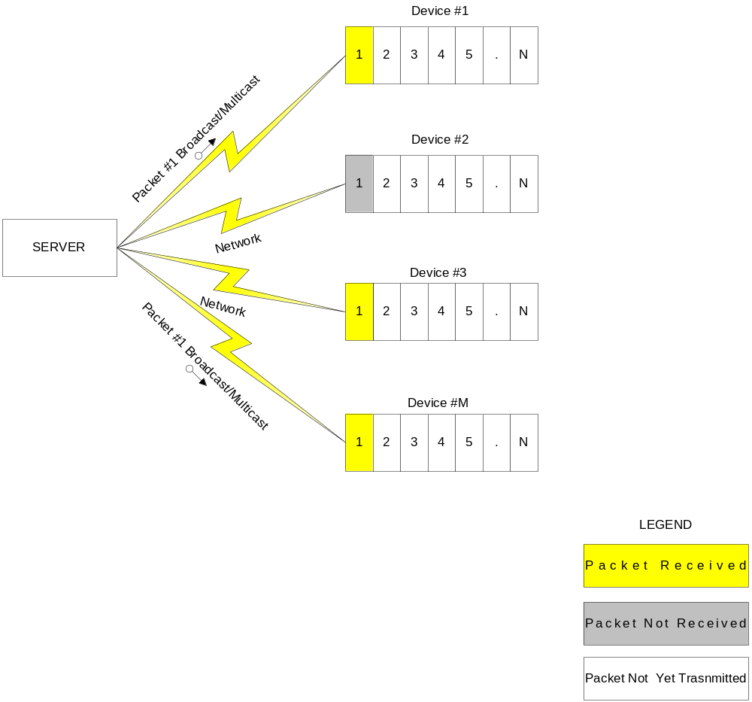
The Proposal of “Mass Up-gradation” ..

Slide 13
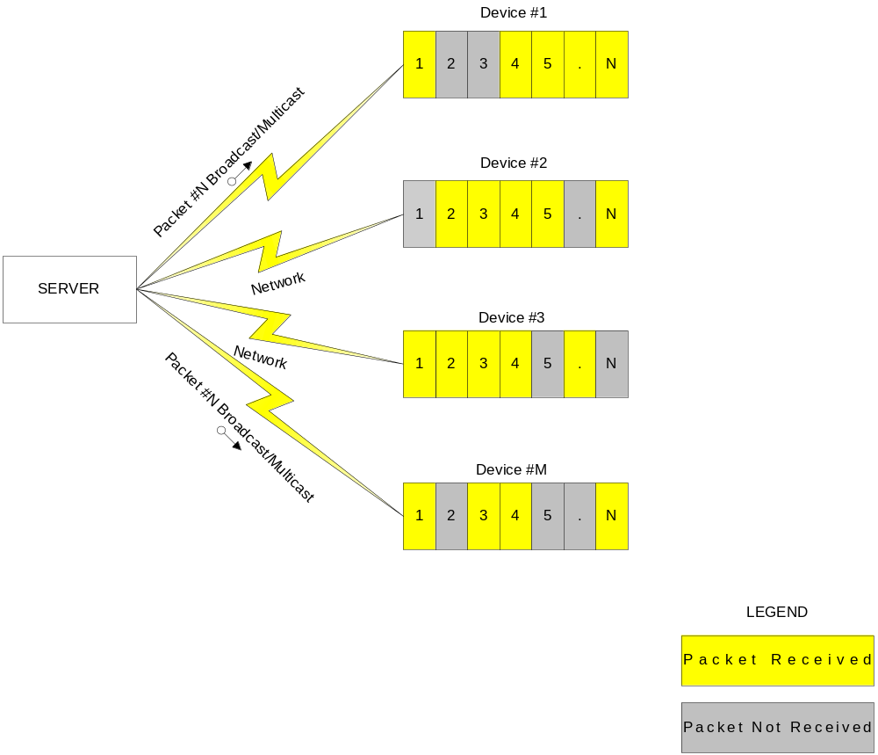
The Proposal of “Mass Up-gradation” ..

Slide 14
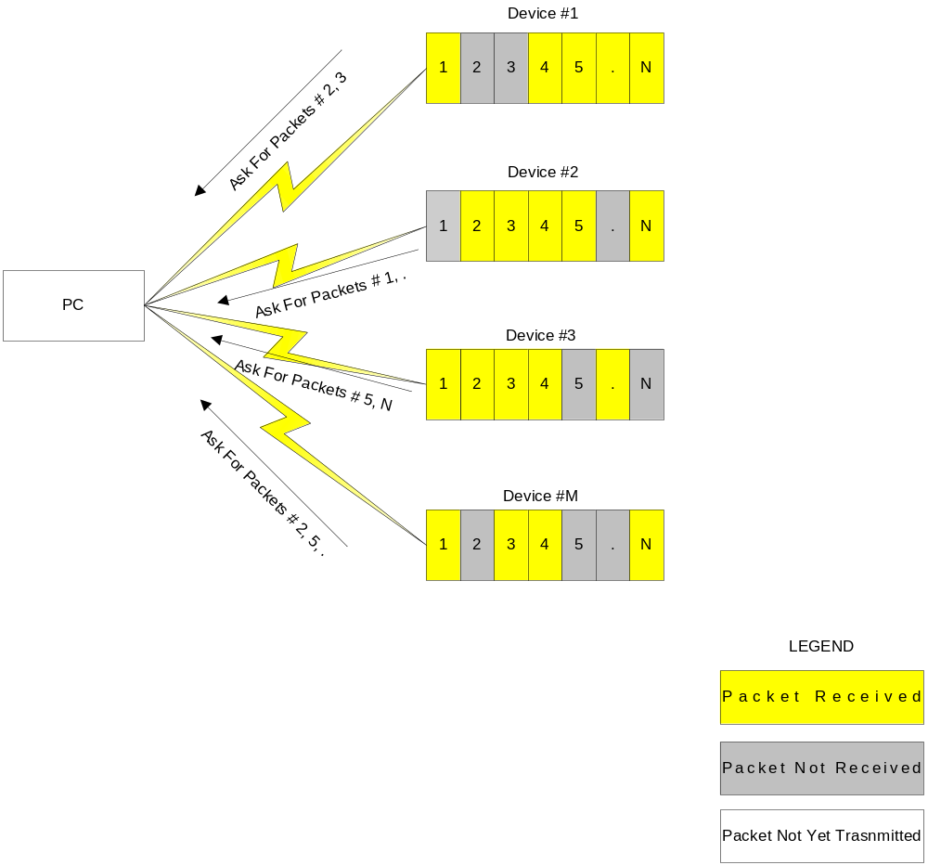
Complain Mode

Slide 15
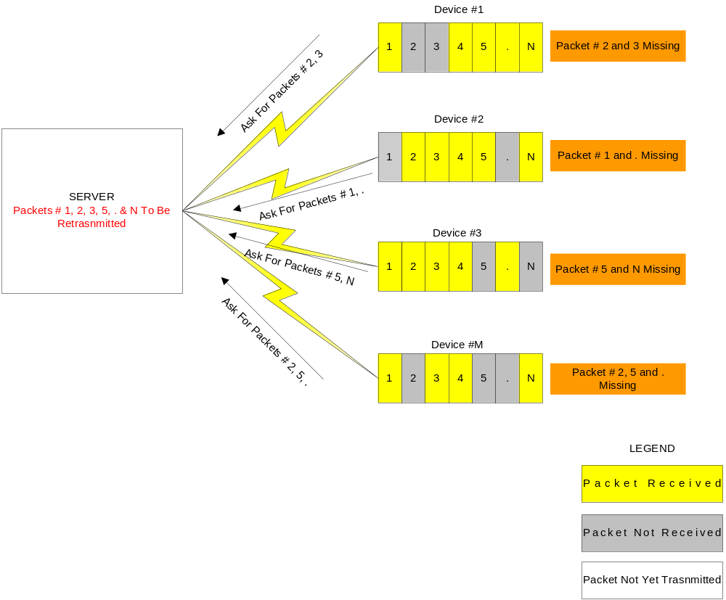
Database Formation & Pattern Matching of Missing Packets

Slide 16
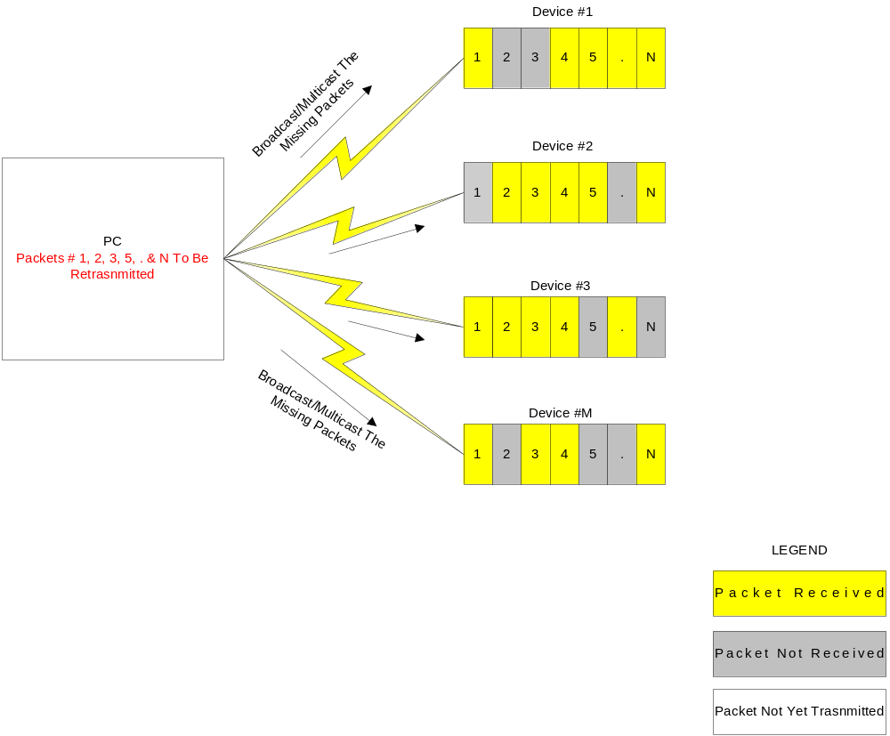
Re-Transmit The Packets

Slide 17
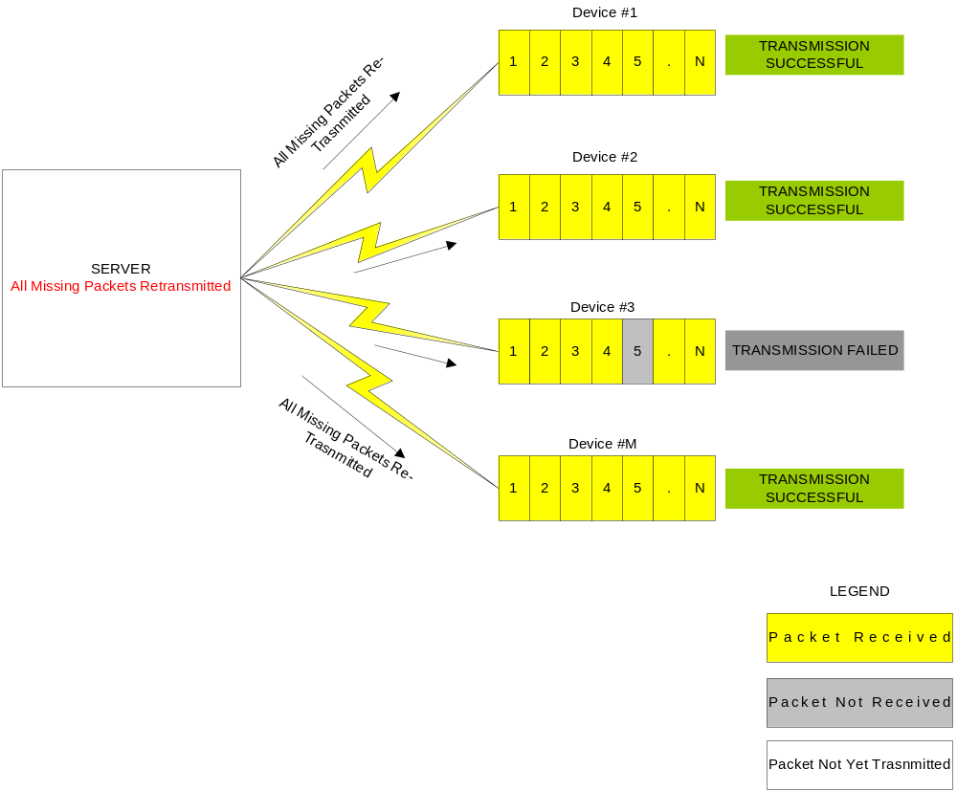
All Missing Packets Retransmitted

Slide 18

How easy to adapt to MSU Client
MSU Client
  Currently MSU only exploit Ethernet (UDP/IP)
  Future may be on many
  MSU is available as C library (source code also available), which can be easily ported
  Currently MSU support two platform (Linux and IPCL (Freescale) )
  The device should have below requirements to adapt to MSU
    Stack required
      UDP/IP
    Number of UDP sockets required
      2
    RAM
      Stack size : 2KBytes
      Global/Heap : 1KBytes + 1.5KBytes(Ethernet Frame size)
    Flash
      Memory Footprint : 12KB (Core component)

Slide 19
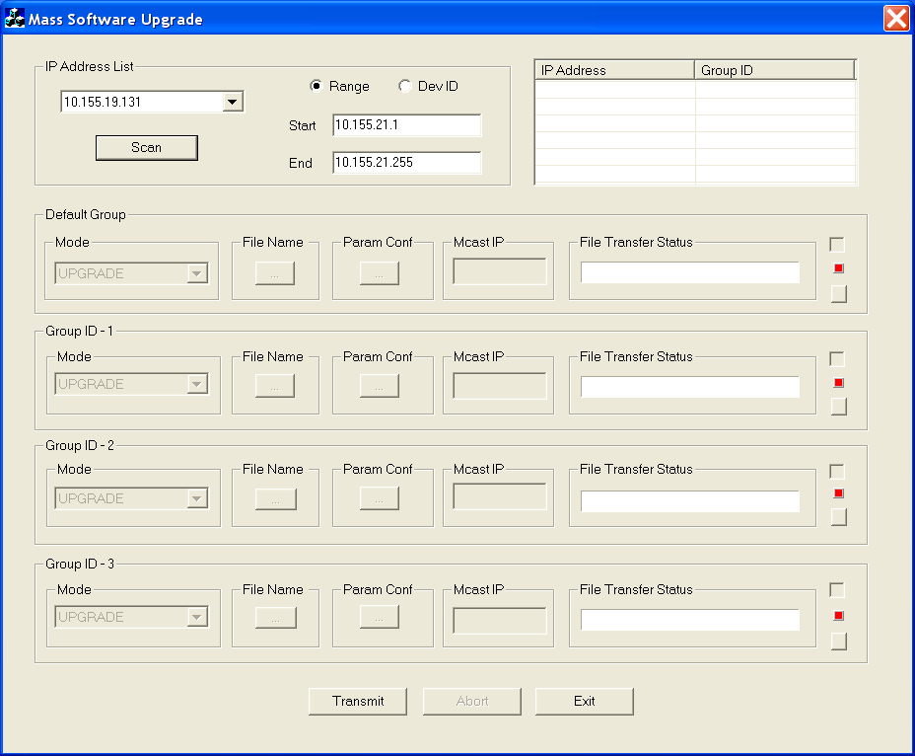
How easy to use MSU Server
MSU server is a standalone PC based application runs on windows XP

Slide 20
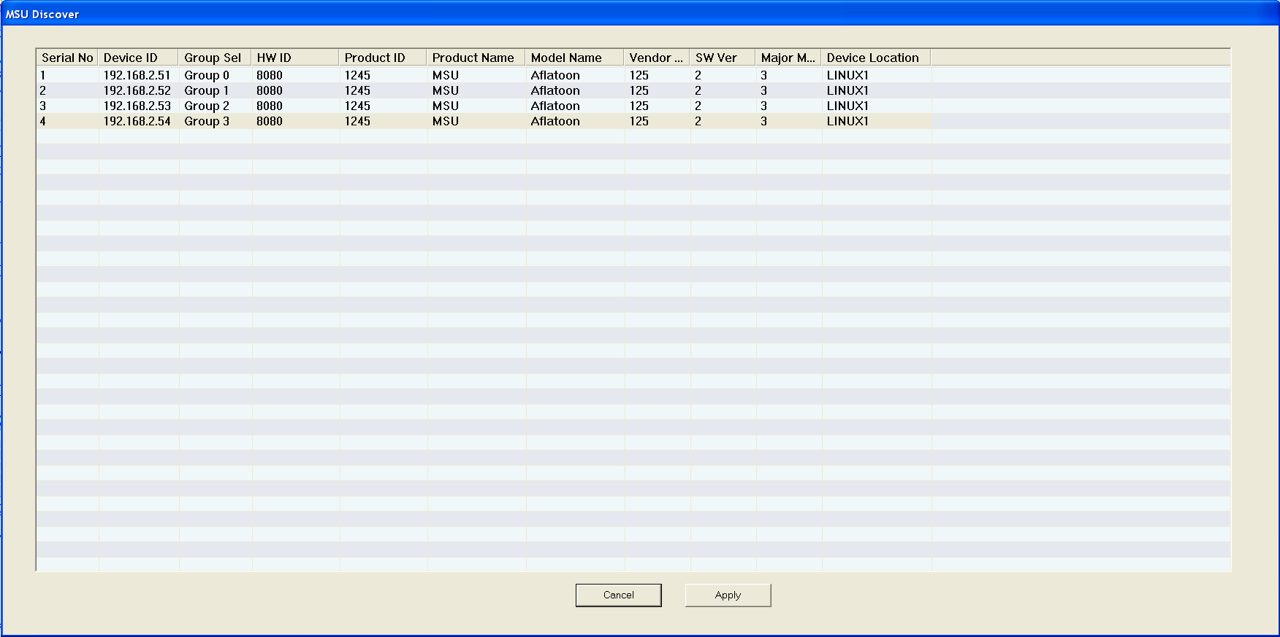
How easy to use MSU server
Discovered devices

Slide 21
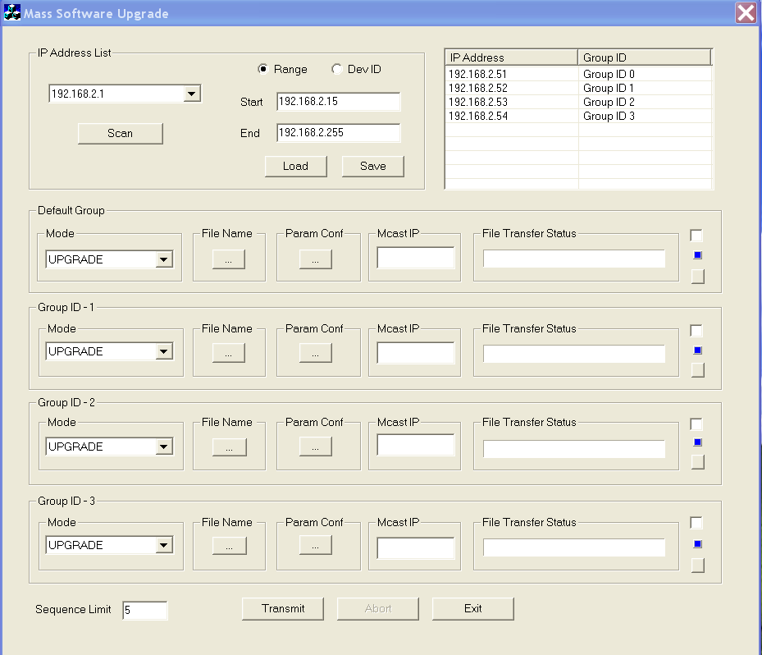
How easy to use MSU server
Group list

Slide 22
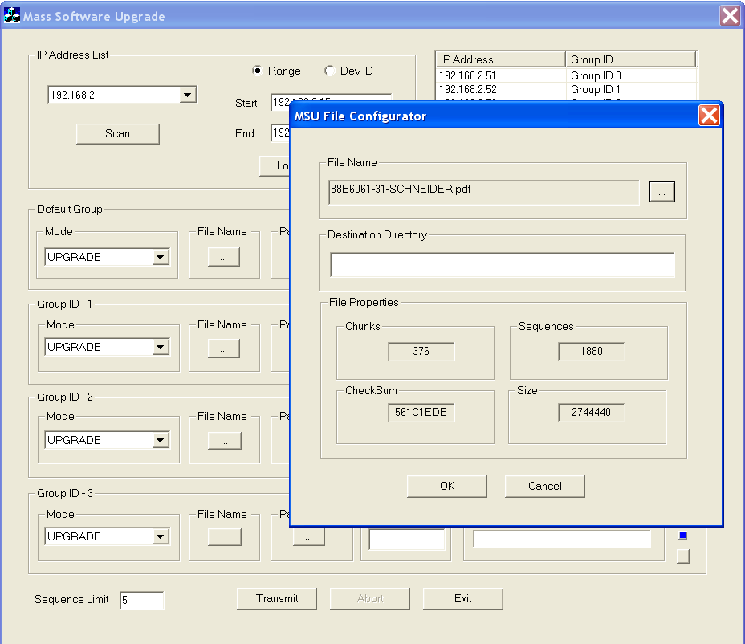
How easy to use MSU server
File selection for different Group

Slide 23
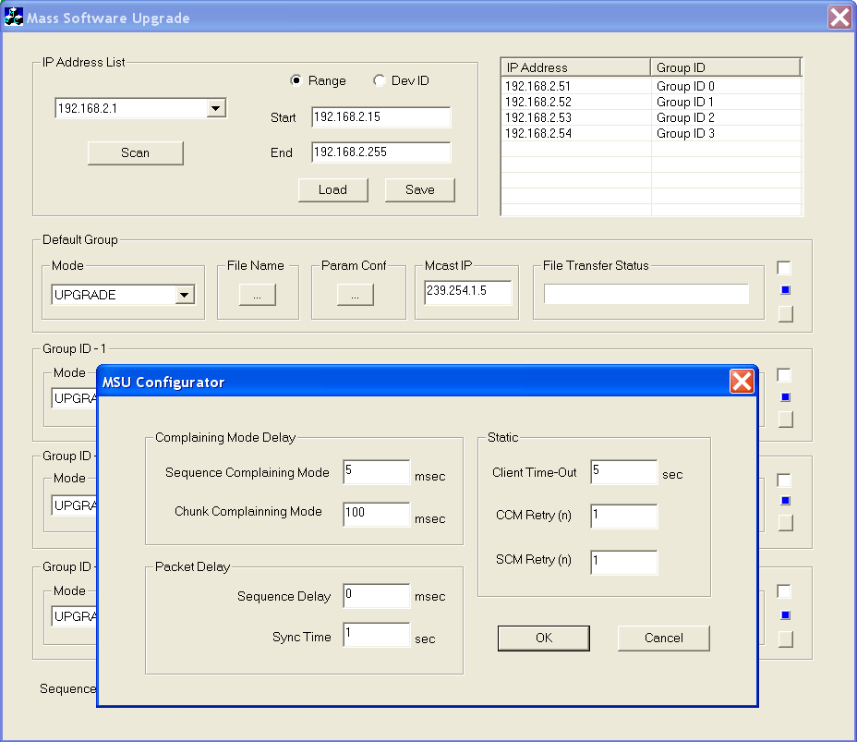
How easy to use MSU server
Communication Parameters selection provided by each Client

Slide 24
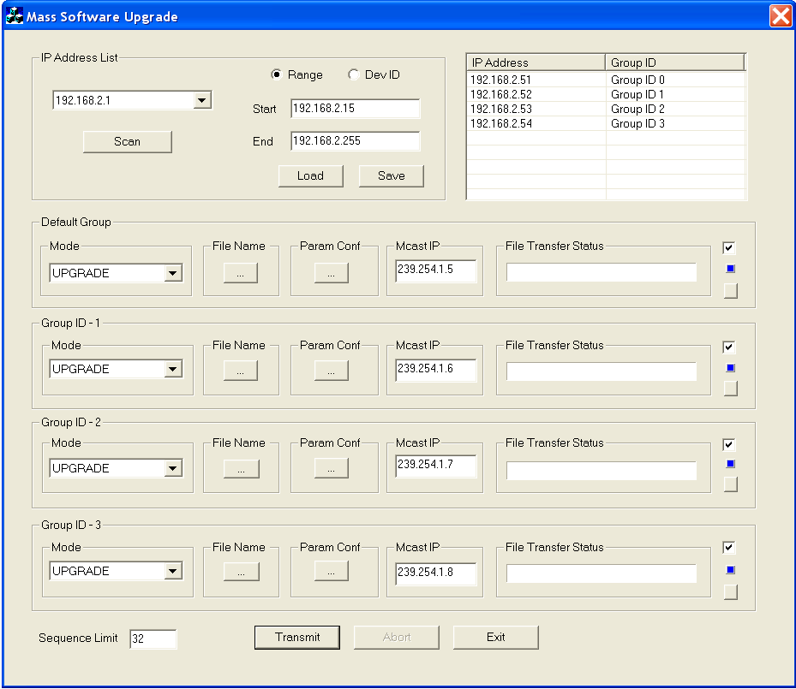
How easy to use MSU server
Ready for Upgrade process
  File selected
  Communication parameters selected
  Multicast IP address is assigned for each group (Automatic)
  Group Selected (Those are going to participate in current upgrade process)

Slide 25
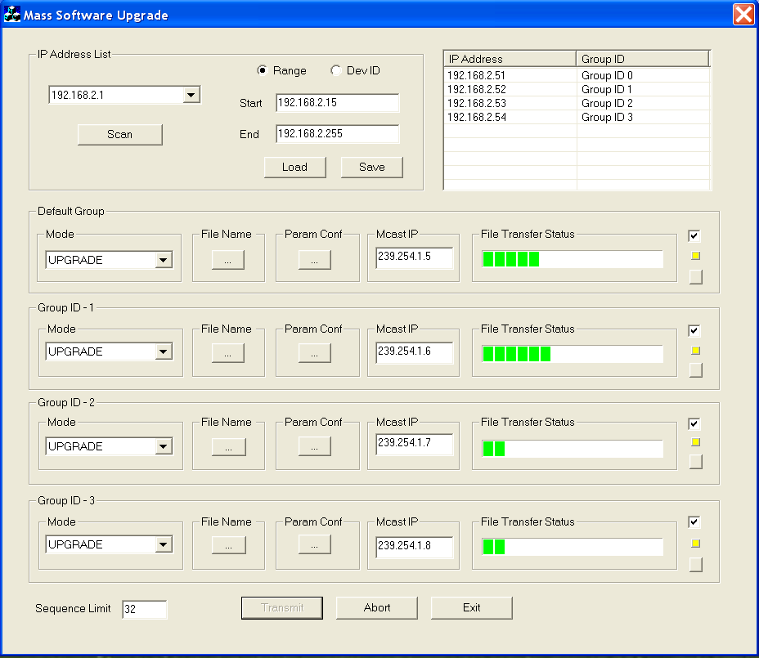
How easy to use MSU server
Start Upgrade process

Slide 26
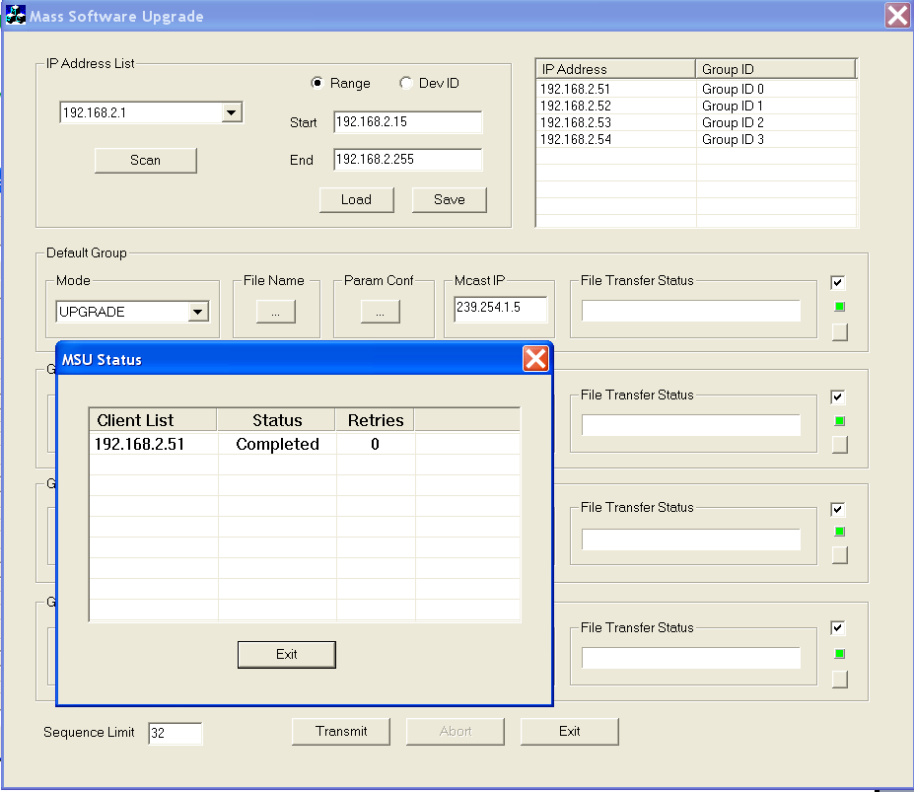
How easy to use MSU server
Finished Upgrade process
  Status of the devices

Slide 27
How easy to use MSU server
Finished Upgrade process
  Status of the devices

Slide 28
How easy to use MSU server
MSU Protocol Specification
MSU Spec

Slide 29
Where we Stand after OTM
Support massive (Common file for all device) only
One to one (each device need specific file) not supported can be expanded
Incremental changes not supported

Slide 30
MSU Porting Option Available
MSU can we configured in following mode
  Temporary storage
  Non temporary storage
Cont……

Slide 31
MSU Porting Option Available
  Temporary storage
    Chunk by chunk : Cache locally a chunk and write to file at the every chunk complete
      Prons
        Reduce the sequence delay interns increase the performance
        Reduction of sequence losses interns reduce the number of retransmission because of sequence processed by TCP/IP stack will be faster
      Cons
        Need to spare the memory in the RAM at least the a chunk size
      Recommendation
        This would be a win-win situation
      Performance
        Almost equal to 1 device upgrade time + 10 to 20% added for protocol over head for whole devices [ w .r. t. network behavior ]
    Whole chunk : Cache locally whole chunk and write to file at complete of file transfer
      Prons
        Reduce the sequence delay as well chunk delay interns high performance
        Almost 0 percentage of sequence losses because of sequence processed by TCP/IP stack will be faster
      Cons
        Need to spare the RAM of complete size of file
      Recommendation
        This would be an Ideal situation in terms of performance
      Implementation
        Can be in kernel
        Can be in Bootloader
      Performance
        Almost equal to 1 device time for whole device [ w .r. t. network behavior ]
  Cont…

Slide 32
MSU Porting Option Available
  Non temporary storage
    Sequence by sequence : No locally cache memory available write the every MSU sequence to file till whole file received
      Prons
        No RAM memory required apart from a frame size
      Cons
        Increase in SCM delay because of slow flash
        Decrease in performance
      Recomandation
        Use when Less RAM and performance is not a criteria
      Performance
        Bit higher then other option due to the flash performance [ w .r. t. network behavior ]

Slide 33
MSU Cyber Security Aspect
  MSU handles the Cyber Security Threat at two level
    Security at System
      Login credential at user and group level on the server [ Only authorized user can start the upgrade process from the server. Device does not check the credential]
    Security at system and Device
      Access Control on the server
        Only authorized user can start the MSU process and before go into the file transfer mode need to send the credential to device in the notification message
      Access Control on the device
        Device must validate the user credential before join the upgrade process
        For invalid user device must decline the current process

Slide 34
MSU Cyber Security Aspect
  Device level credential
    Validate at the time of process start
      Server send the credential information to the device in the Notification message
      Device will validate the credential before join the upgrade process
    Validate at the time of process start as well every sequence receive from the server
      Server send the credential information to the device in the Notification message
      Device will validate the credential before join the upgrade process
      Server need to send the credential in each sequence
      Device will receive the sequence only credential passed else reject
  Various security threat
    Low
      Accidental or unintentional security threat
    Medium
      Intentional security threat
      Hake between the process
    High
      Using complex mechanism or tool to hake the complete process
      Later remotely can start fake process and

Slide 35
MSU Cyber Security Aspect
  Remedy at different level
    Low
      Credential only use before the process start
    Medium
      Credential use before the process start
      Credential use in every message exchange
    High
      Credential use before the process start
      Credential use in every message exchange
      Only register server start the process request from other source would be consider as a invalid process

Slide 36
Thank you for your kind attention !

